Slide 1
#SinoSiJUAN?
Analysis of the 2022 PH Elections

Slide 2
#SinoSiJUAN?
BAILIWICK ANALYSIS

Slide 3
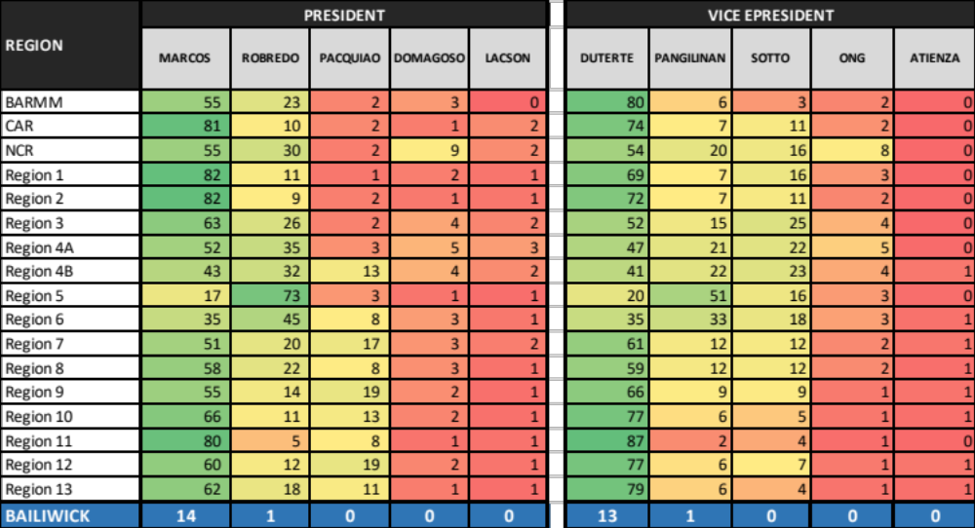
Regional

Slide 4
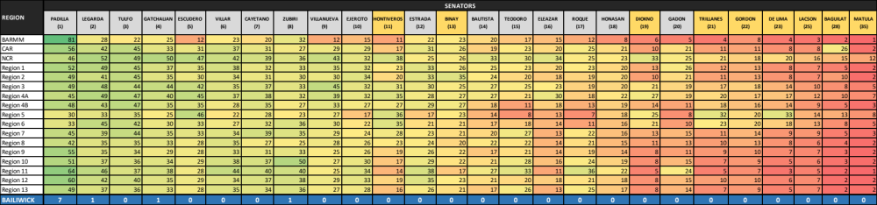
Regional

Slide 5
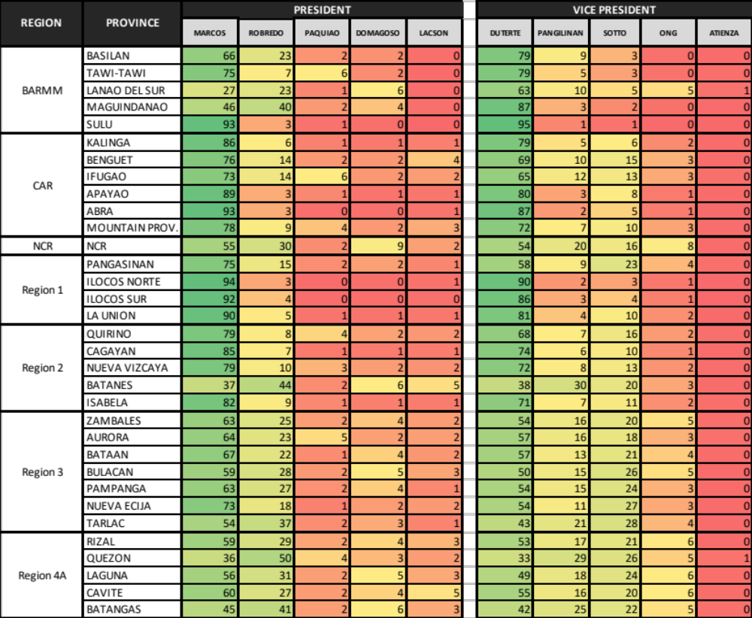
Provincial

Slide 6
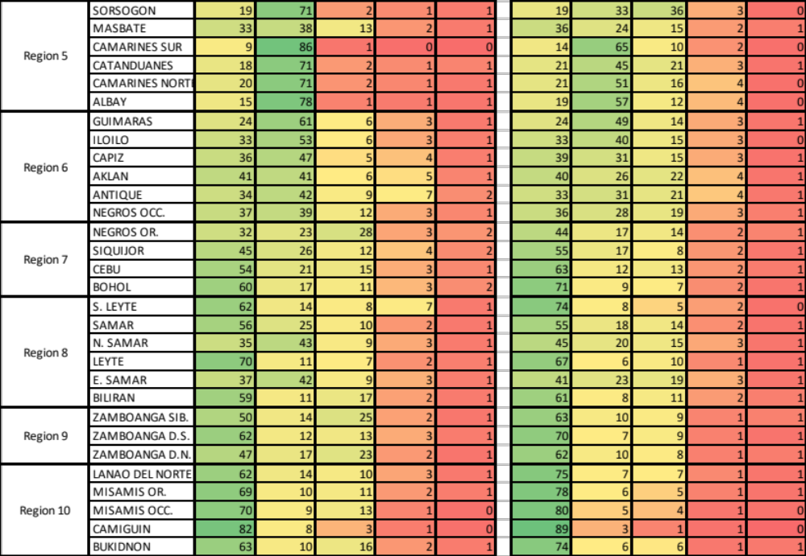
Provincial

Slide 7
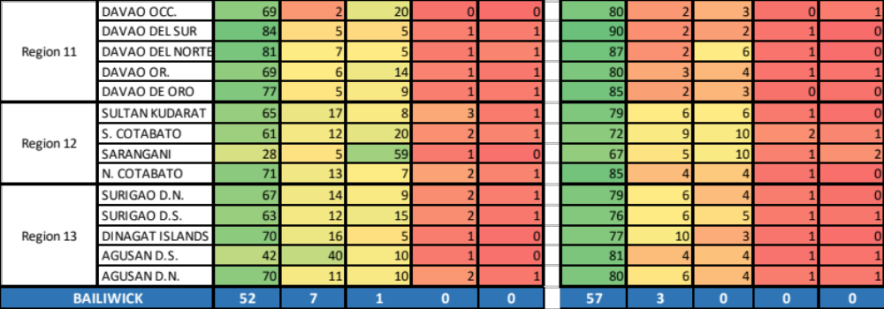
Provincial

Slide 8
REGION | PROVINCE | SENATORS
 |  | PADILLA | LEGARDA | TULFO | GATCHALIAN | ESCUDERO | VILLAR | CAYETANO | ZUBIRI | VILLANUEVA | EJERCITO | HONTIVEROS | ESTRADA | BINAY
BARMM | BASILAN | 79.1 | 22.0 | 22.1 | 15.3 | 16.1 | 20.3 | 20.3 | 20.3 | 15.9 | 16.5 | 10.2 | 17.0 | 16.5
 | TAWI-TAWI | 74.1 | 21.8 | 26.2 | 24.9 | 10.1 | 25.4 | 16.8 | 25.8 | 20.1 | 14.8 | 6.1 | 20.9 | 20.3
 | LANAO DEL SUR | 76.4 | 19.0 | 16.9 | 14.1 | 9.0 | 16.2 | 11.9 | 36.4 | 9.9 | 11.1 | 9.1 | 12.1 | 15.7
 | MAGUINDANAO | 80.8 | 28.9 | 24.8 | 25.0 | 12.5 | 26.4 | 13.4 | 38.7 | 14.3 | 14.9 | 15.1 | 16.2 | 20.4
 | SULU | 90.7 | 46.4 | 24.3 | 46.2 | 12.3 | 26.3 | 47.2 | 21.8 | 4.5 | 21.5 | 8.9 | 52.1 | 42.6
CAR | KALINGA | 57.6 | 36.2 | 43.2 | 29.0 | 25.3 | 30.4 | 29.1 | 24.1 | 22.1 | 27.5 | 14.8 | 34.5 | 27.3
 | BENGUET | 56.4 | 47.7 | 49.2 | 37.7 | 35.6 | 40.7 | 35.8 | 34.0 | 34.1 | 26.3 | 21.6 | 24.5 | 17.6
 | IFUGAO | 51.5 | 39.8 | 44.8 | 26.6 | 24.9 | 28.7 | 31.8 | 24.4 | 25.7 | 26.3 | 16.5 | 30.4 | 27.8
 | APAYAO | 50.0 | 43.4 | 43.9 | 32.3 | 30.7 | 37.2 | 33.9 | 28.4 | 28.9 | 34.7 | 18.2 | 34.8 | 35.0
 | ABRA | 59.7 | 35.6 | 38.0 | 35.0 | 33.9 | 41.8 | 22.3 | 21.1 | 29.6 | 37.7 | 11.8 | 41.9 | 39.1
 | MOUNTAIN PROV. | 54.6 | 38.4 | 46.9 | 26.6 | 25.4 | 35.4 | 30.1 | 21.2 | 25.2 | 25.6 | 13.5 | 26.7 | 24.9
NCR | NCR | 45.9 | 51.8 | 49.0 | 50.1 | 47.3 | 42.0 | 39.0 | 35.9 | 43.2 | 32.5 | 37.6 | 24.9 | 25.8
----- | ----- | ----- | ----- | ----- | ----- | ----- | ----- | ----- | ----- | ----- | ----- | ----- | ----- | -----
Region 11 | DAVAO OCC. | 54.9 | 29.6 | 24.2 | 22.3 | 18.5 | 25.2 | 26.8 | 26.6 | 19.0 | 26.5 | 9.1 | 28.5 | 15.5
 | DAVAO DEL SUR | 68.3 | 52.6 | 34.5 | 45.0 | 28.6 | 51.9 | 45.0 | 46.2 | 27.7 | 35.9 | 13.7 | 40.3 | 16.4
 | DAVAO DEL NORTE | 65.8 | 48.9 | 39.4 | 38.7 | 29.0 | 44.6 | 40.8 | 43.8 | 26.3 | 34.4 | 16.7 | 40.3 | 20.0
 | DAVAO OR. | 51.9 | 34.7 | 41.7 | 28.6 | 25.2 | 33.1 | 35.6 | 28.0 | 24.6 | 29.8 | 12.6 | 28.6 | 18.1
 | DAVAO DE ORO | 62.7 | 41.5 | 38.9 | 32.6 | 29.6 | 38.2 | 33.7 | 36.1 | 20.3 | 35.0 | 13.1 | 36.8 | 15.6
Region 12 | SULTAN KUDARAT | 67.6 | 39.5 | 35.5 | 37.7 | 27.7 | 36.3 | 39.6 | 40.1 | 30.8 | 31.9 | 17.8 | 43.1 | 28.8
 | S. COTABATO | 57.8 | 49.8 | 44.9 | 40.0 | 34.5 | 36.7 | 42.0 | 40.9 | 34.3 | 36.9 | 26.5 | 38.2 | 24.2
 | SARANGANI | 50.9 | 36.1 | 42.7 | 24.4 | 25.5 | 26.4 | 29.4 | 27.5 | 22.7 | 28.5 | 15.8 | 27.8 | 26.2
 | N. COTABATO | 61.5 | 35.8 | 34.3 | 30.5 | 25.2 | 33.0 | 31.2 | 38.9 | 24.1 | 30.1 | 12.6 | 31.0 | 17.6
Region 13 | SURIGAO D.N. | 47.8 | 33.4 | 42.6 | 32.8 | 31.5 | 31.9 | 35.3 | 32.3 | 22.4 | 24.9 | 14.8 | 28.9 | 18.7
 | SURIGAO D.S. | 53.1 | 32.6 | 38.8 | 26.9 | 26.1 | 30.3 | 34.7 | 30.3 | 21.5 | 24.2 | 16.3 | 26.2 | 19.4
 | DINAGAT ISLANDS | 53.0 | 36.2 | 32.5 | 34.6 | 19.1 | 33.8 | 27.5 | 37.1 | 16.8 | 17.8 | 18.2 | 32.3 | 16.5
 | AGUSAN D.S. | 44.3 | 40.0 | 34.6 | 36.6 | 31.6 | 36.8 | 38.8 | 40.6 | 34.1 | 35.5 | 17.1 | 24.3 | 21.0
 | AGUSAN D.N. | 49.3 | 41.6 | 31.4 | 36.6 | 24.1 | 41.6 | 29.6 | 42.1 | 31.3 | 30.3 | 14.9 | 22.2 | 24.5
BAILIWICK |  | 35 | 11 | 1 | 3 | 2 | 2 | 2 | 2 | 1 | 0 | 0 | 1 | 0
Provincial

Slide 9
REGION | PROVINCE | SENTAOPRS
 |  | BAUTISTA | TEODORO | ELEAZAR | ROQUE | HONASAN | DIOKNO | GADON | TRILLANES | GORDON | DE LIMA | LACSON | BAGUILAT | MATULA
BARMM | BASILAN | 8.8 | 16.1 | 6.5 | 11.2 | 9.5 | 4.6 | 6.8 | 5.8 | 7.2 | 3.8 | 3.7 | 2.8 | 1.0
 | TAWI-TAWI | 14.9 | 7.7 | 11.5 | 17.2 | 9.8 | 3.9 | 4.7 | 3.9 | 5.2 | 3.8 | 3.9 | 2.1 | 1.2
 | LANAO DEL SUR | 18.8 | 7.2 | 10.2 | 7.3 | 4.7 | 7.7 | 3.8 | 4.3 | 9.2 | 4.9 | 4.2 | 1.6 | 1.1
 | MAGUINDANAO | 15.9 | 11.6 | 11.9 | 12.9 | 10.9 | 6.7 | 6.5 | 3.8 | 8.8 | 4.5 | 2.8 | 2.9 | 1.1
 | SULU | 38.6 | 44.8 | 35.6 | 16.2 | 3.4 | 2.6 | 3.6 | 1.5 | 8.0 | 0.6 | 1.1 | 1.9 | 0.3
CAR | KALINGA | 18.7 | 22.4 | 13.9 | 23.9 | 23.4 | 8.6 | 22.3 | 10.8 | 12.8 | 6.9 | 10.0 | 17.3 | 1.9
 | BENGUET | 20.0 | 26.6 | 25.1 | 28.3 | 23.1 | 15.4 | 24.3 | 12.2 | 12.3 | 9.3 | 8.4 | 25.7 | 4.1
 | IFUGAO | 16.1 | 14.5 | 15.0 | 17.3 | 19.3 | 8.1 | 16.5 | 11.0 | 9.7 | 8.4 | 7.7 | 71.0 | 1.7
 | APAYAO | 18.8 | 21.7 | 12.2 | 19.6 | 18.3 | 5.8 | 14.4 | 8.9 | 10.2 | 5.2 | 7.3 | 5.8 | 1.0
 | ABRA | 18.6 | 26.2 | 25.8 | 29.8 | 16.3 | 6.5 | 20.2 | 6.7 | 8.9 | 5.0 | 5.1 | 3.1 | 1.1
 | MOUNTAIN PROV. | 16.6 | 15.1 | 13.3 | 23.0 | 18.9 | 8.1 | 17.8 | 11.7 | 9.2 | 8.9 | 8.7 | 35.4 | 1.6
NCR | NCR | 32.7 | 29.7 | 34.2 | 24.6 | 23.2 | 33.1 | 25.5 | 20.7 | 18.4 | 20.4 | 16.0 | 15.3 | 11.7
----- | ----- | ----- | ----- | ----- | ----- | ----- | ----- | ----- | ----- | ----- | ----- | ----- | ----- | -----
Region 11 | DAVAO OCC. | 25.7 | 23.5 | 6.3 | 20.4 | 16.0 | 3.0 | 10.8 | 4.1 | 5.0 | 2.8 | 4.6 | 1.2 | 0.5
 | DAVAO DEL SUR | 33.4 | 40.5 | 13.2 | 44.4 | 27.1 | 6.0 | 31.9 | 4.5 | 7.1 | 2.9 | 4.7 | 1.8 | 1.1
 | DAVAO DEL NORTE | 26.4 | 33.4 | 12.6 | 36.5 | 24.1 | 6.1 | 26.0 | 5.7 | 9.0 | 3.0 | 5.7 | 1.4 | 0.9
 | DAVAO OR. | 14.5 | 22.8 | 8.6 | 22.3 | 13.8 | 4.5 | 12.8 | 4.7 | 7.2 | 3.8 | 5.6 | 1.5 | 0.9
 | DAVAO DE ORO | 24.1 | 26.4 | 8.9 | 30.5 | 16.4 | 4.2 | 15.9 | 5.2 | 7.5 | 3.0 | 5.3 | 1.3 | 0.7
Region 12 | SULTAN KUDARAT | 27.4 | 20.0 | 21.8 | 25.8 | 19.7 | 6.4 | 12.3 | 10.5 | 9.6 | 5.5 | 6.3 | 2.0 | 1.6
 | S. COTABATO | 22.9 | 22.9 | 21.7 | 23.5 | 20.8 | 12.0 | 20.5 | 13.8 | 13.6 | 8.0 | 9.0 | 3.2 | 2.2
 | SARANGANI | 12.0 | 14.8 | 12.1 | 15.5 | 13.6 | 6.1 | 9.9 | 8.8 | 8.9 | 5.1 | 6.4 | 1.9 | 1.1
 | N. COTABATO | 17.9 | 18.8 | 13.8 | 19.0 | 15.6 | 5.1 | 12.2 | 6.1 | 7.4 | 3.6 | 5.2 | 1.5 | 0.9
Region 13 | SURIGAO D.N. | 24.8 | 22.4 | 11.5 | 19.5 | 16.2 | 8.7 | 14.4 | 7.9 | 11.7 | 5.4 | 9.3 | 2.7 | 1.9
 | SURIGAO D.S. | 16.4 | 18.4 | 12.0 | 21.1 | 15.5 | 7.4 | 13.9 | 7.5 | 10.0 | 4.9 | 6.6 | 2.1 | 1.5
 | DINAGAT ISLANDS | 25.0 | 25.9 | 8.4 | 28.3 | 23.0 | 7.0 | 19.0 | 6.7 | 8.0 | 5.4 | 5.8 | 3.2 | 1.8
 | AGUSAN D.S. | 12.5 | 31.8 | 10.4 | 28.0 | 24.8 | 5.5 | 11.9 | 6.8 | 7.7 | 5.9 | 5.2 | 1.9 | 4.4
 | AGUSAN D.N. | 14.9 | 31.5 | 18.7 | 29.6 | 13.2 | 8.5 | 15.0 | 6.5 | 7.6 | 4.8 | 5.4 | 2.6 | 2.2
BAILIWICK |  | 1 | 1 | 0 | 0 | 1 | 0 | 0 | 0 | 0 | 0 | 0 | 1 | ------
Provincial

Slide 10
2016-2022
REGION | LENI |  |  | MARCOS
 | LENI 2016 | BAM 2019 | LENI 2022 | BBM 2016 | IMEE 2019 | BBM 2022
CAR | 14% | 18% | 10% | 61% | 52% | 81%
NCR | 27% | 37% | 31% | 43% | 44% | 55%
Region 1 | 9% | 19% | 11% | 77% | 66% | 82%
Region 2 | 14% | 24% | 9% | 63% | 50% | 82%
Region 3 | 26% | 35% | 26% | 44% | 38% | 63%
Region 4A | 35% | 35% | 35% | 27% | 27% | 52%
Region 4B | 41% | 31% | 32% | 19% | 22% | 43%
Region 5 | 56% | 44% | 73% | 7% | 13% | 17%
Region 6 | 56% | 40% | 45% | 12% | 19% | 35%
Region 7 | 40% | 26% | 20% | 11% | 22% | 51%
Region 8 | 31% | 23% | 22% | 29% | 28% | 58%
Region 9 | 31% | 15% | 14% | 22% | 21% | 55%
Region 10 | 36% | 17% | 11% | 18% | 29% | 66%
Region 11 | 15% | 16% | 5% | 23% | 35% | 80%
Region 12 | 26% | 20% | 12% | 33% | 32% | 60%
Region 13 | 38% | 18% | 18% | 17% | 29% | 62%
BARMM | 38% | 10% | 23% | 19% | 16% | 55%
BAILIWICK | 2 | 0 | 1 | 3 | 0 | 14

Slide 11
#SinoSiJUAN?
CORRELATIONAL STUDY

Slide 12
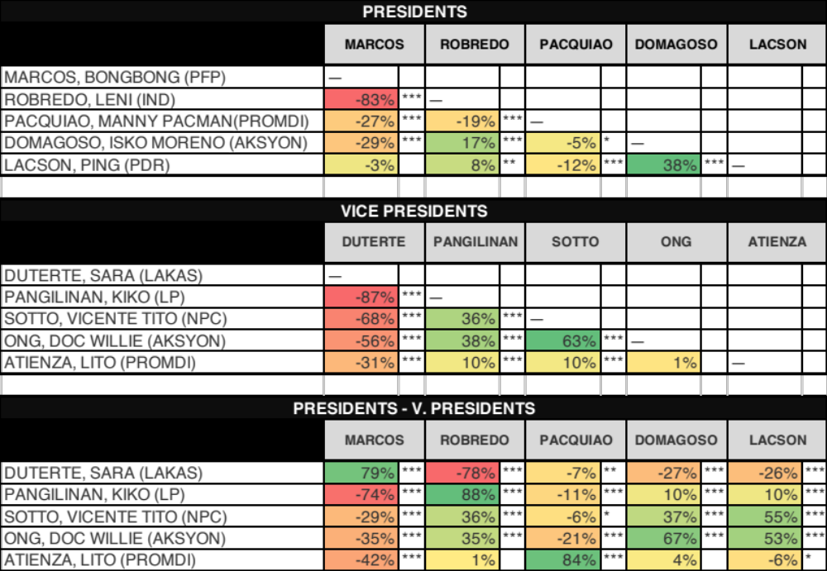
2022 NLE

Slide 13
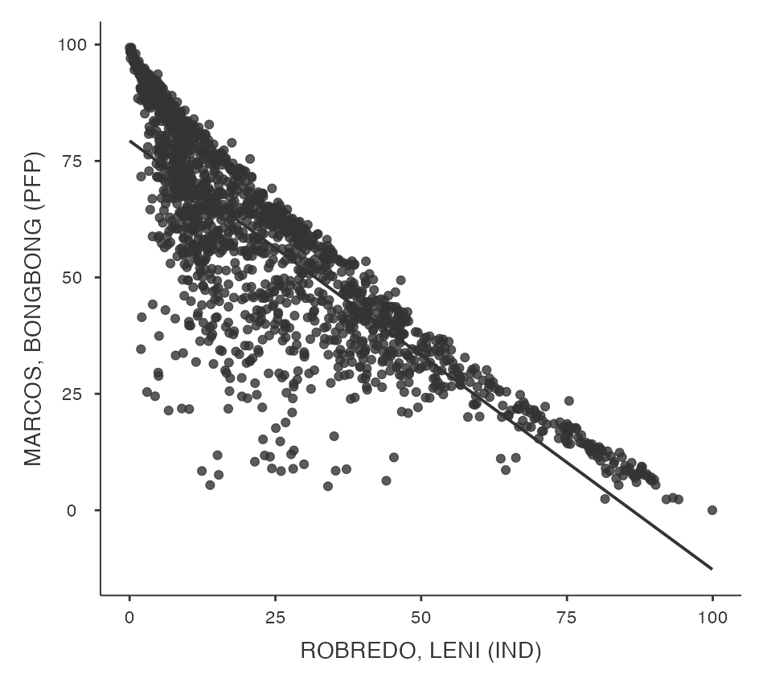
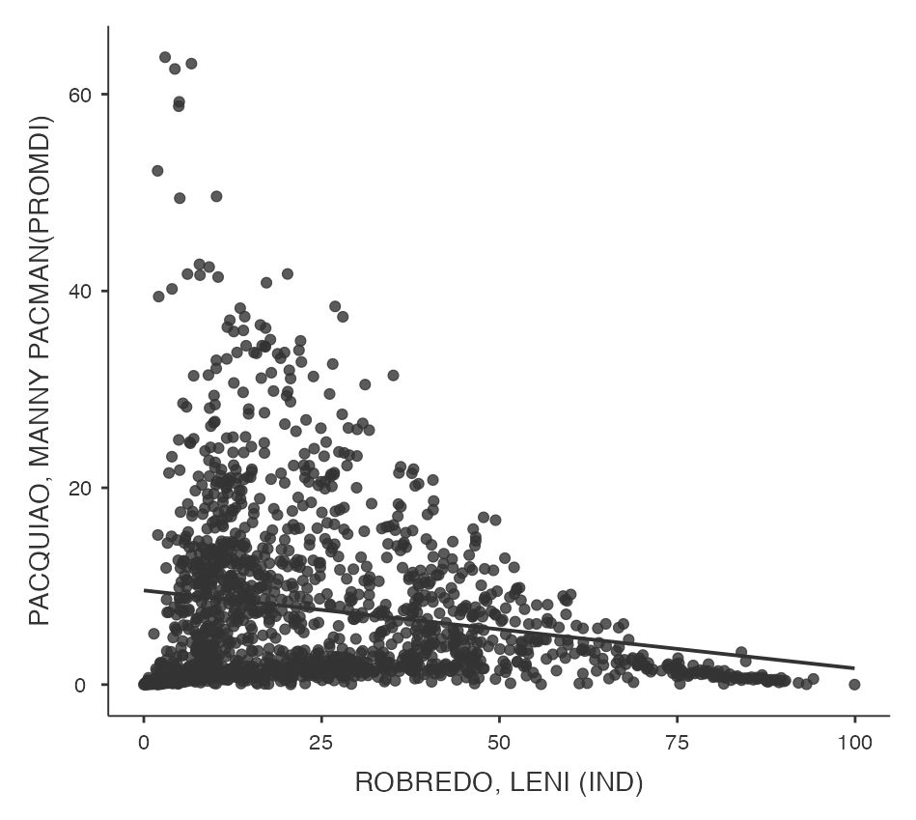

Slide 14
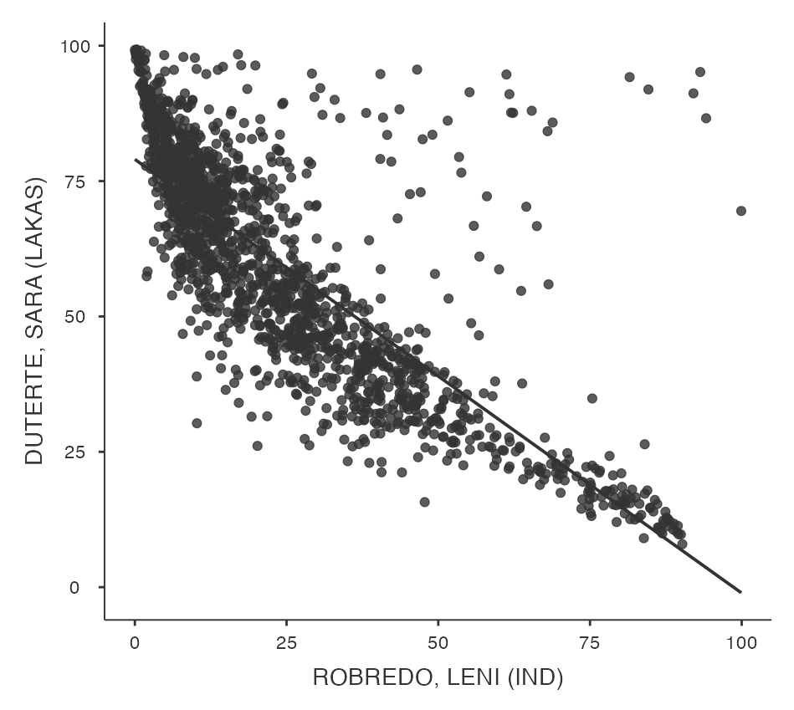
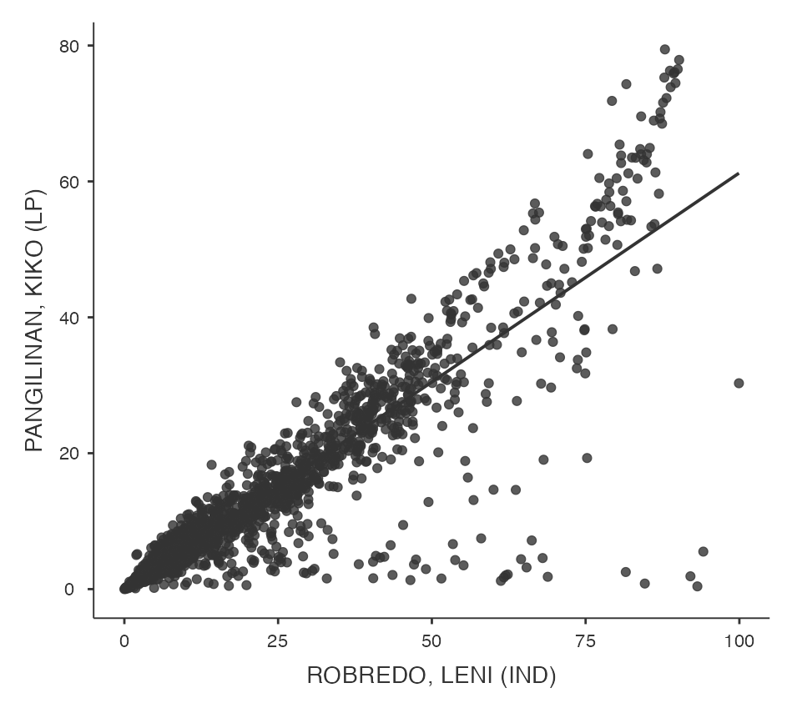

Slide 15
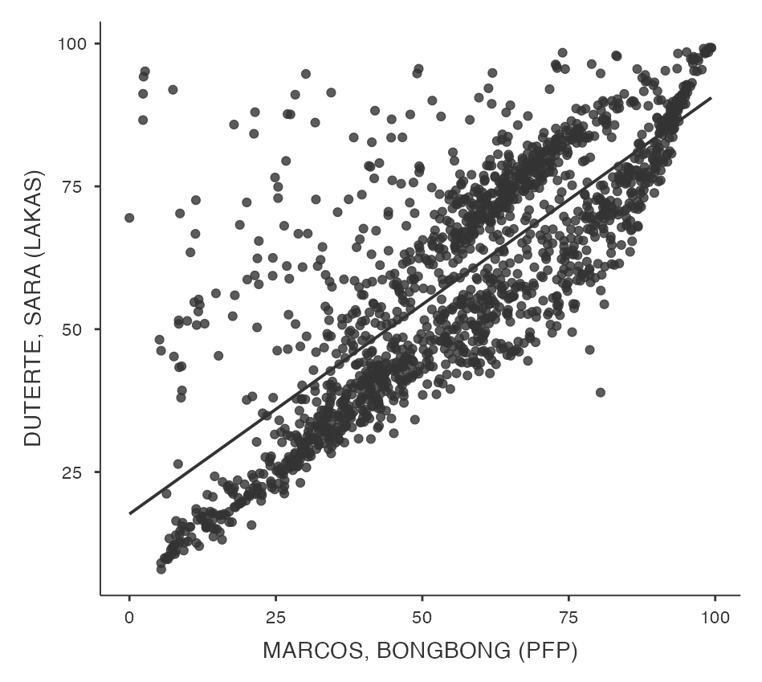

Slide 16
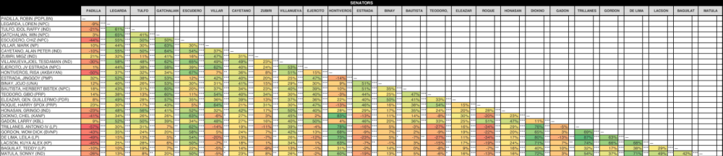
2022 NLE

Slide 17
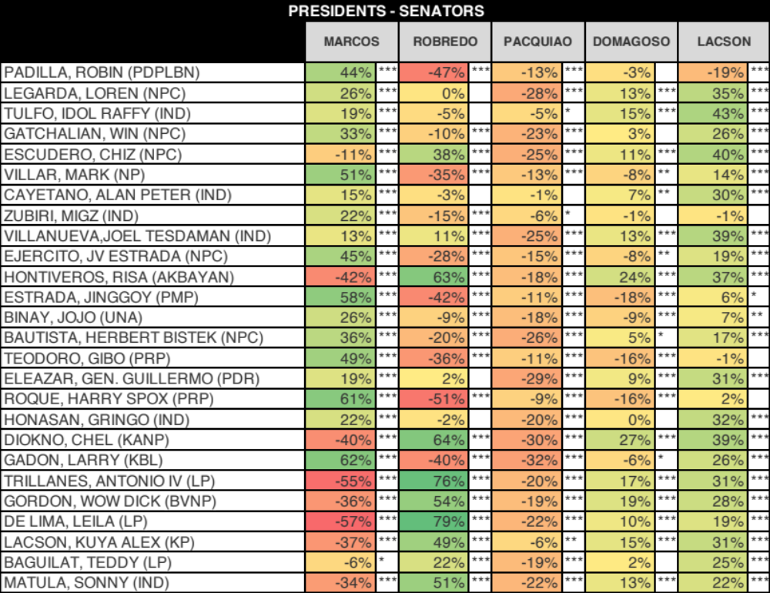
2022 NLE

Slide 18
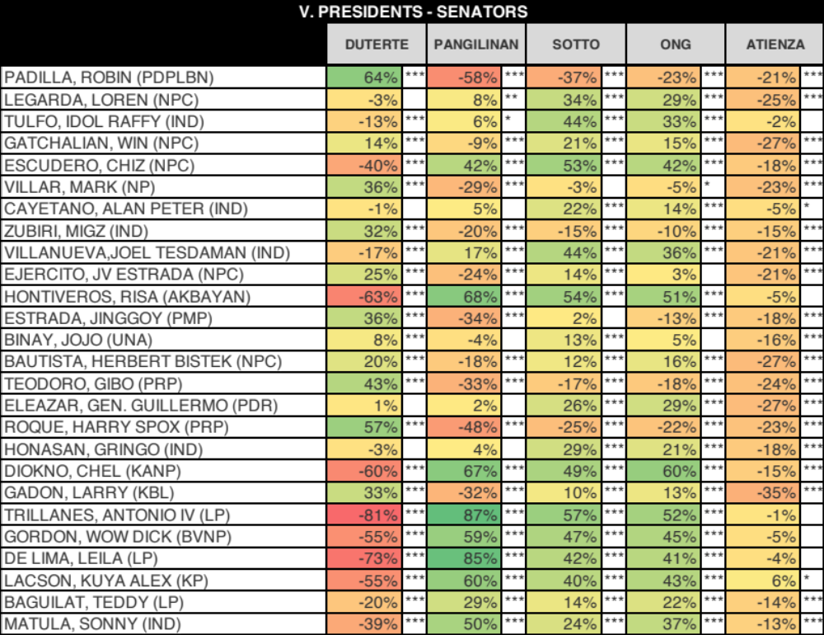
2022 NLE

Slide 19
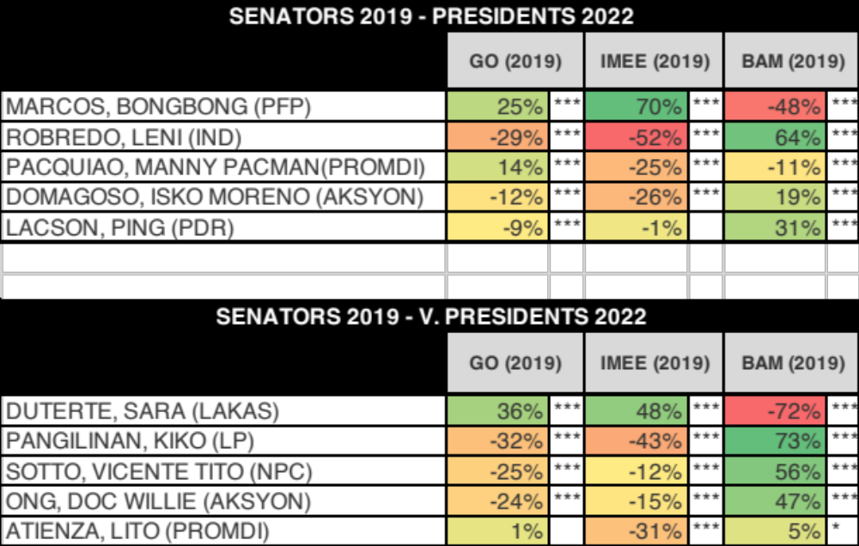
2019 & 2022

Slide 21
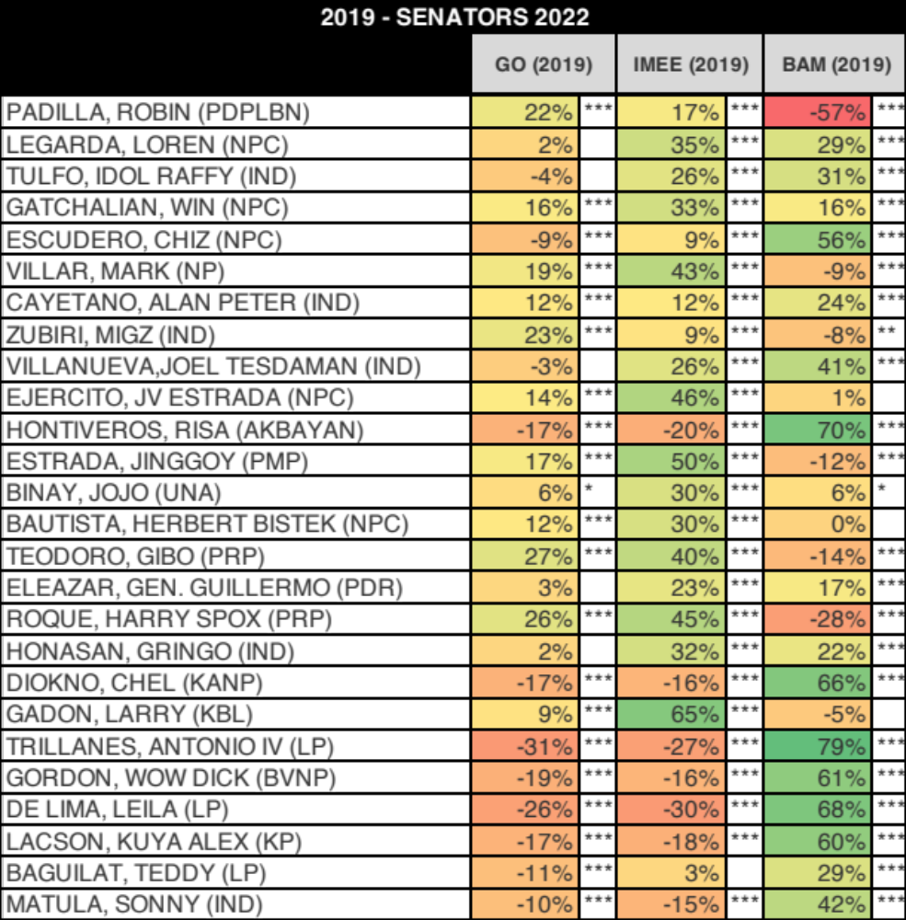
2019 & 2022

Slide 22
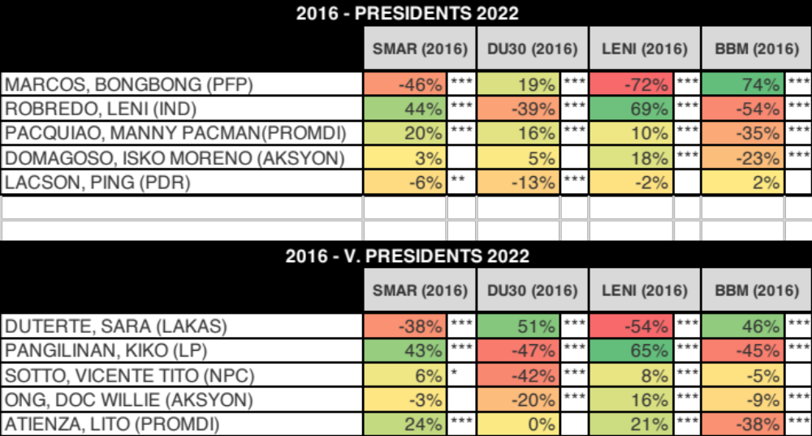
2016 & 2022

Slide 23
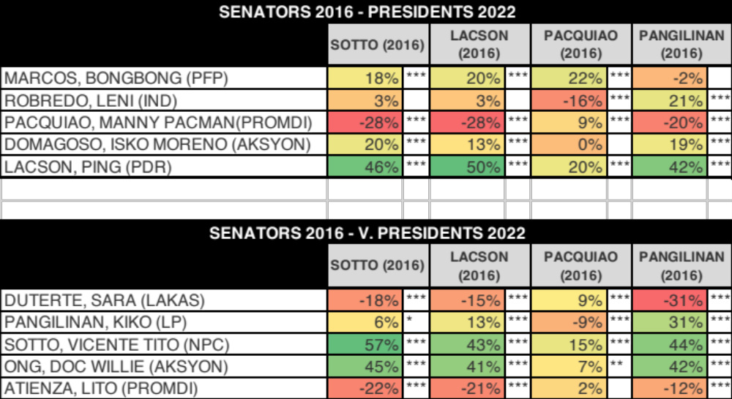
2016 & 2022

Slide 24
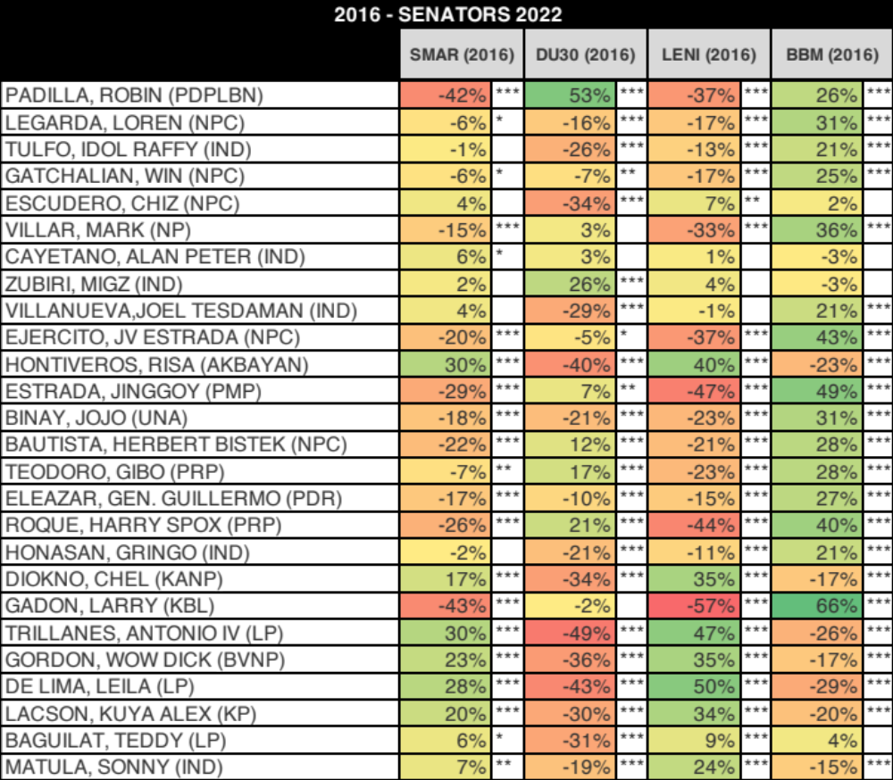
2016 & 2022

